Slide 1
Formal Semantics of
Programming Languages
Introduction

Slide 2
Programming Languages
A fundamental field in computer science
  As classic as OS and Architectures
    SOSP: 1967；ISCA: 1973；POPL: 1973
Old, but still very active
  Many important research problems
  New languages keep showing up
    Rust, Go, Scala, F#, Kotlin, Julia, Swift, Typescript, Dart, Solidity, WebAssembly, Carbon, Mojo, Zig, Nim, Taichi, 仓颉, …

Slide 3
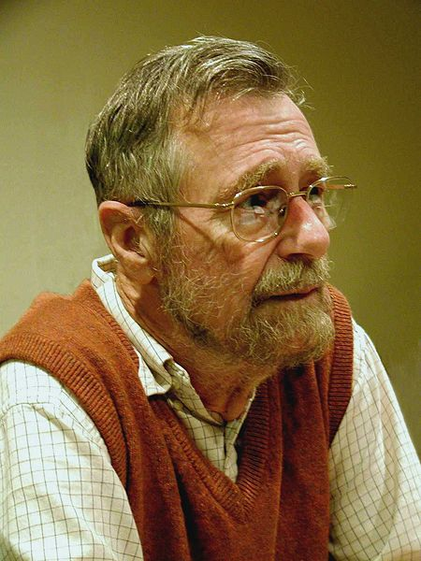
Programming Languages
Computer Science is no more about computers than astronomy is about telescopes.
Edsger W. Dijkstra
How about PL then?

Slide 4
Programming Languages
PL research is broader than designing and implementing new languages. To me, a PL researcher is someone who views the programming language as having a central place in solving computing problems. From this vantage point, PL researchers tend to focus on developing general abstractions, or building blocks, for solving problems, or classes of problems. PL research also considers software behavior in a rigorous and general way, e.g., to prove that (classes of) programs enjoy properties we want, and/or eschew properties we don’t. This approach has proven to be very valuable for solving a wide ranging set of problems.
Blog post by Mike Hicks:
What is PL research and how is it useful? - The PL Enthusiast
www.pl-enthusiast.net/2015/05/27/what-is-pl-research-and-how-is-it-useful/

Slide 5
Formal Semantics
To assign mathematical meanings to
language contructs & programs
A scientific way to study PL and programming
  “developing general abstractions”

Slide 6
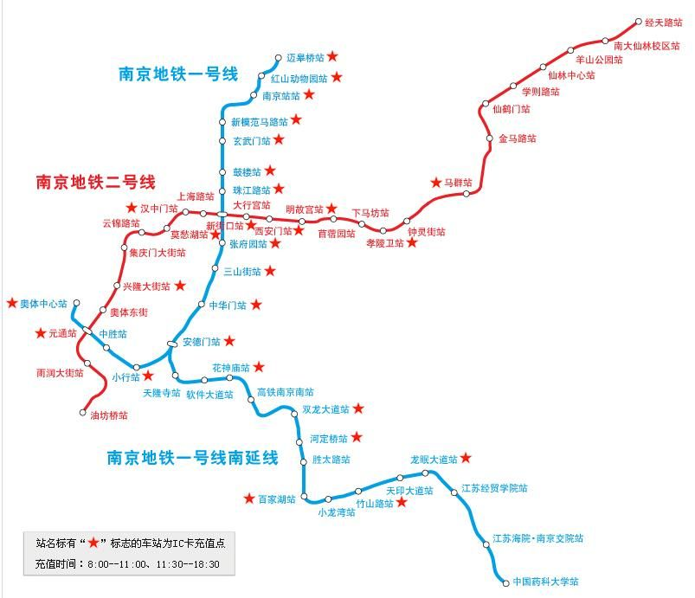
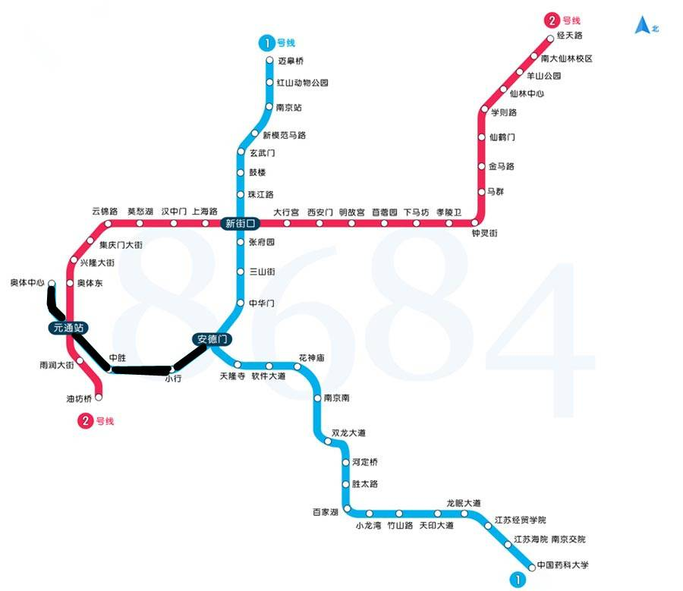
Abstraction

Slide 7
Abstraction
The purpose of abstraction is not to be vague, but to create a new semantic level in which one can be absolutely precise.
Edsger W. Dijkstra

Slide 8
Formal Semantics
To assign mathematical meanings to
language contructs & programs
A scientific way to study PL and programming
  “developing general abstractions”
  “considers software behavior in a rigorous and general way”
    More than testing

Slide 9
factorial( n )
{
c = n;
result = 1;
while (c>1) {
result = result * c;
c = c-1;
}
return result;
}
Is it correct?
What do we mean by correctness?

Slide 10
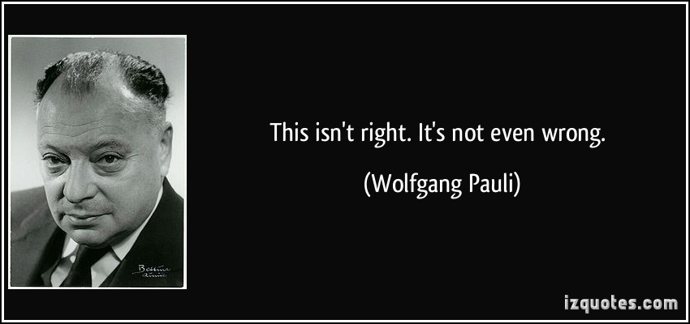
factorial( n )
{
c = n;
result = 1;
while (c>1) {
result = result * c;
c = c-1;
}
return result;
}
Is it correct?
What do we mean by correctness?

Slide 11
{ n ≥ 0 }
factorial( n )
{
c = n;
result = 1;
while (c>1) {
result = result * c;
c = c-1;
}
return result;
}
{ result = n!/c!}
{ result = n!/c! ∧ c=1}
{ result = n! }

Slide 12
We’ll try to answer question like:
How to describe meanings of programs?
How to describe properties of programs?
How to reason about programs?
How to tell if two programs have the same behaviors or not?
How to design a new language?

Slide 13
Why take this course?
Software reliability and security are the biggest problems faced by the IT industry today!
  You are likely to worry about them in your future job!

Slide 14
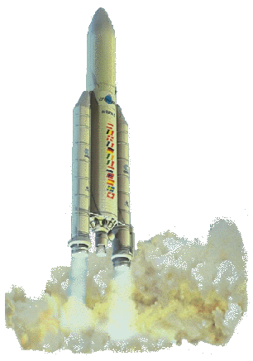
Arianne 5
40 seconds into its flight it veered off course and exploded.
“Conversion of a 64bit integer into a 16bit signed integer leads to an overflow.”
This picture become quite popular in talks on software reliability
On June 4, 1996, the Arianne 5 took off on its maiden flight.

Slide 15
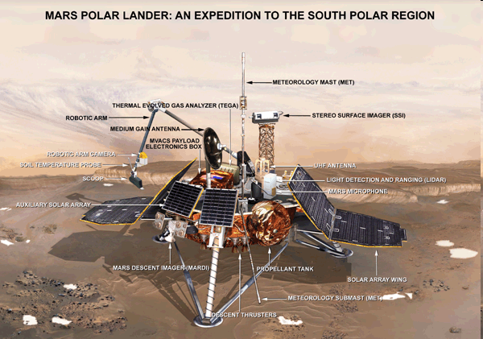
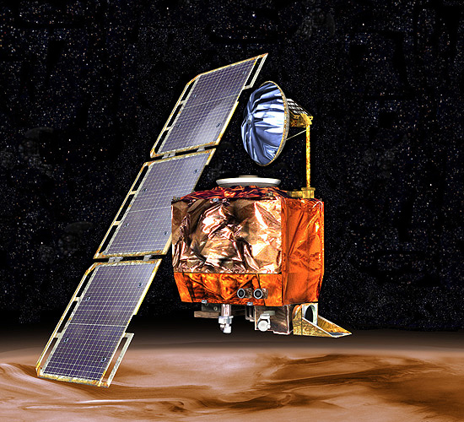
“Better, Faster, Cheaper”
In 1999, NASA lost both the Mars Polar Lander and the Climate Orbiter.
Later investigations determined software errors were to blame.
  Orbiter: Component reuse error.
  Lander: Precondition violation.

Slide 16
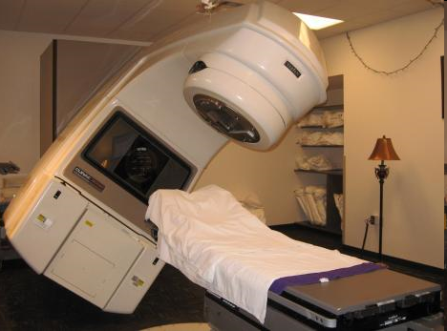
Therac-25
From 1985-1987, 6 patients were killed or seriously injured as a result of overdosed radiation (100 times of the intended dose) by Therac-25, a radiation treatment facility.
The problem was due to a subtle race
condition between concurrent processes.

Slide 17
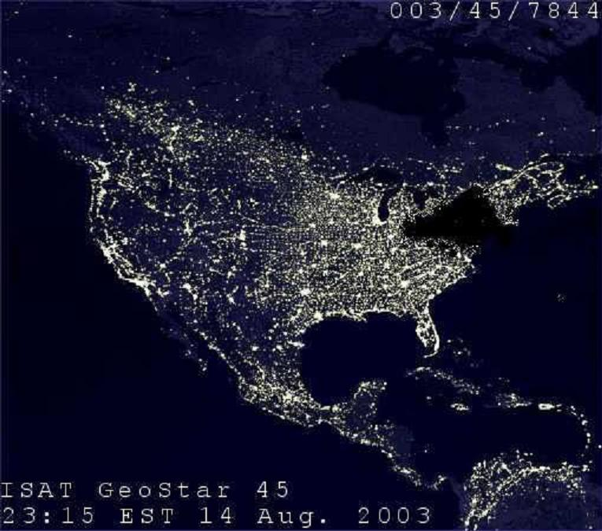
Northeast blackout, 2003
A widespread power outage that occurred throughout parts of the Northeastern and Midwestern United States and Ontario, Canada on Thursday, August 14, 2003
Race conditions in GE Energy's Unix-based XA/21 energy management system caused alarm system failure.

Slide 18
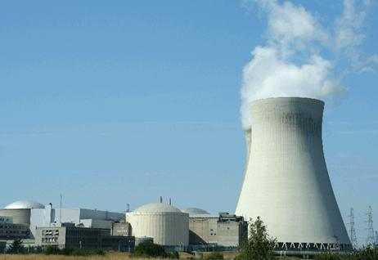
Now think of viruses and Trojan Horses
Stuxnet is used to attack the nuclear power station in Iran in 2010.
The virus took advantage of 4 undeclared bugs in windows to take over the system.

Slide 19
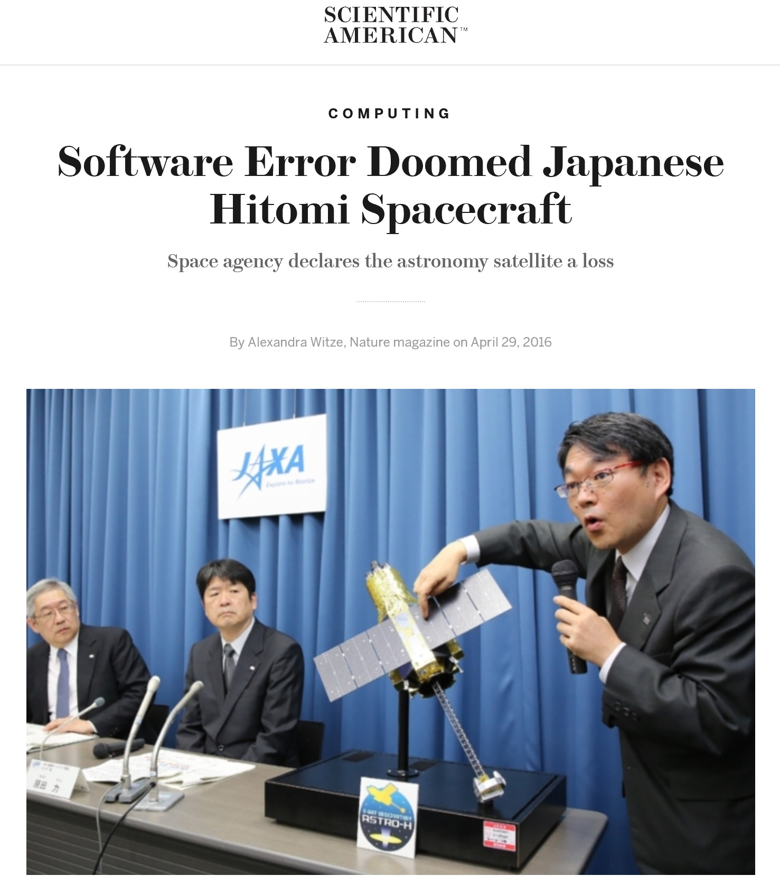
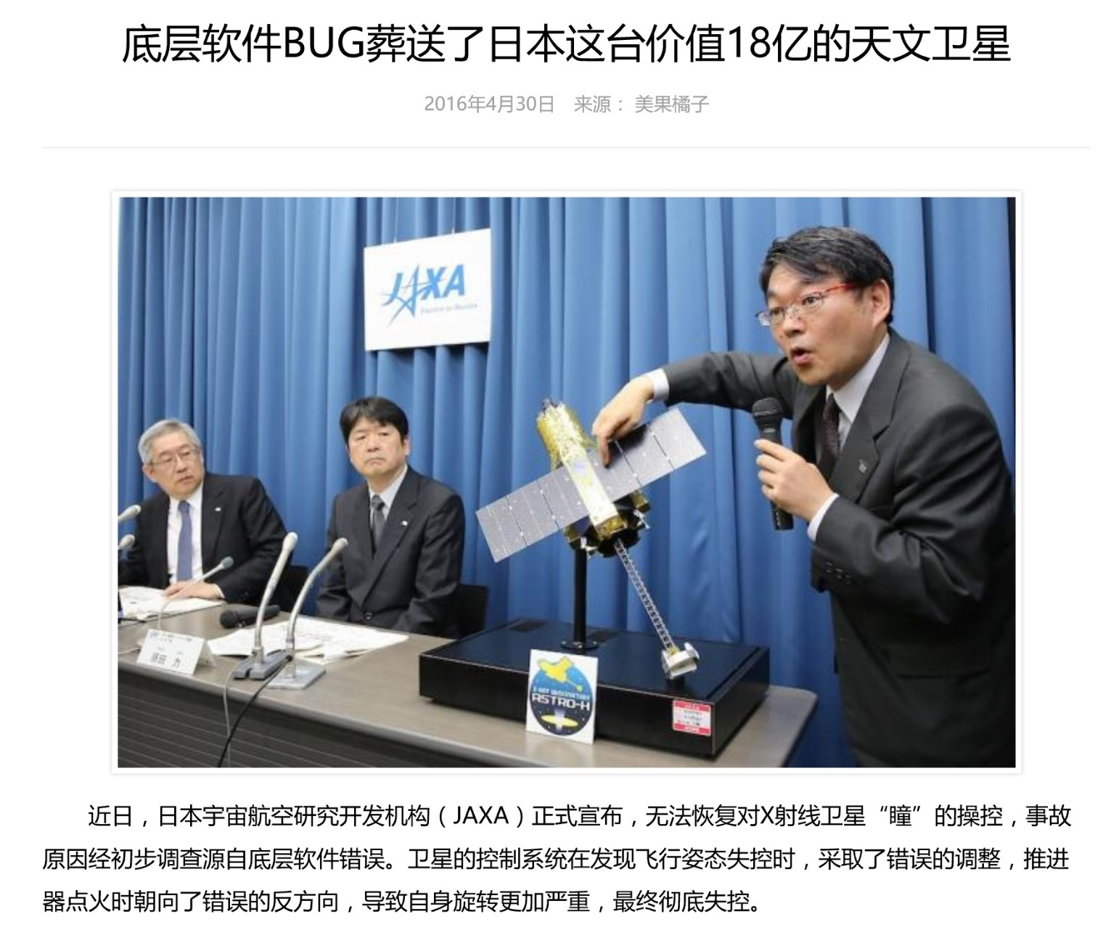
Notes:
http://hackaday.com/2016/05/02/software-update-destroys-286-million-japanese-satellite/
http://www.scientificamerican.com/article/software-error-doomed-japanese-hitomi-spacecraft/?print=true
http://www.wanhuajing.com/d409485

Slide 20
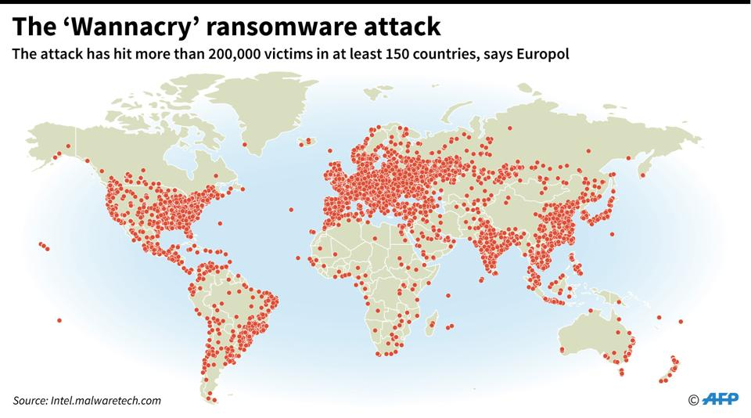
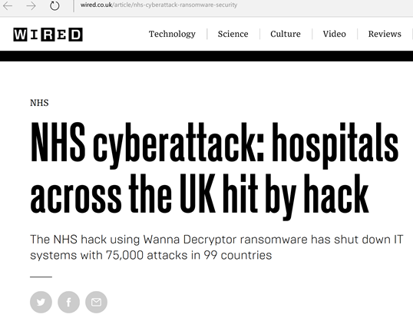
2017年5月Wannacry勒索软件攻击
利用Windows操作系统的缺陷

Slide 21
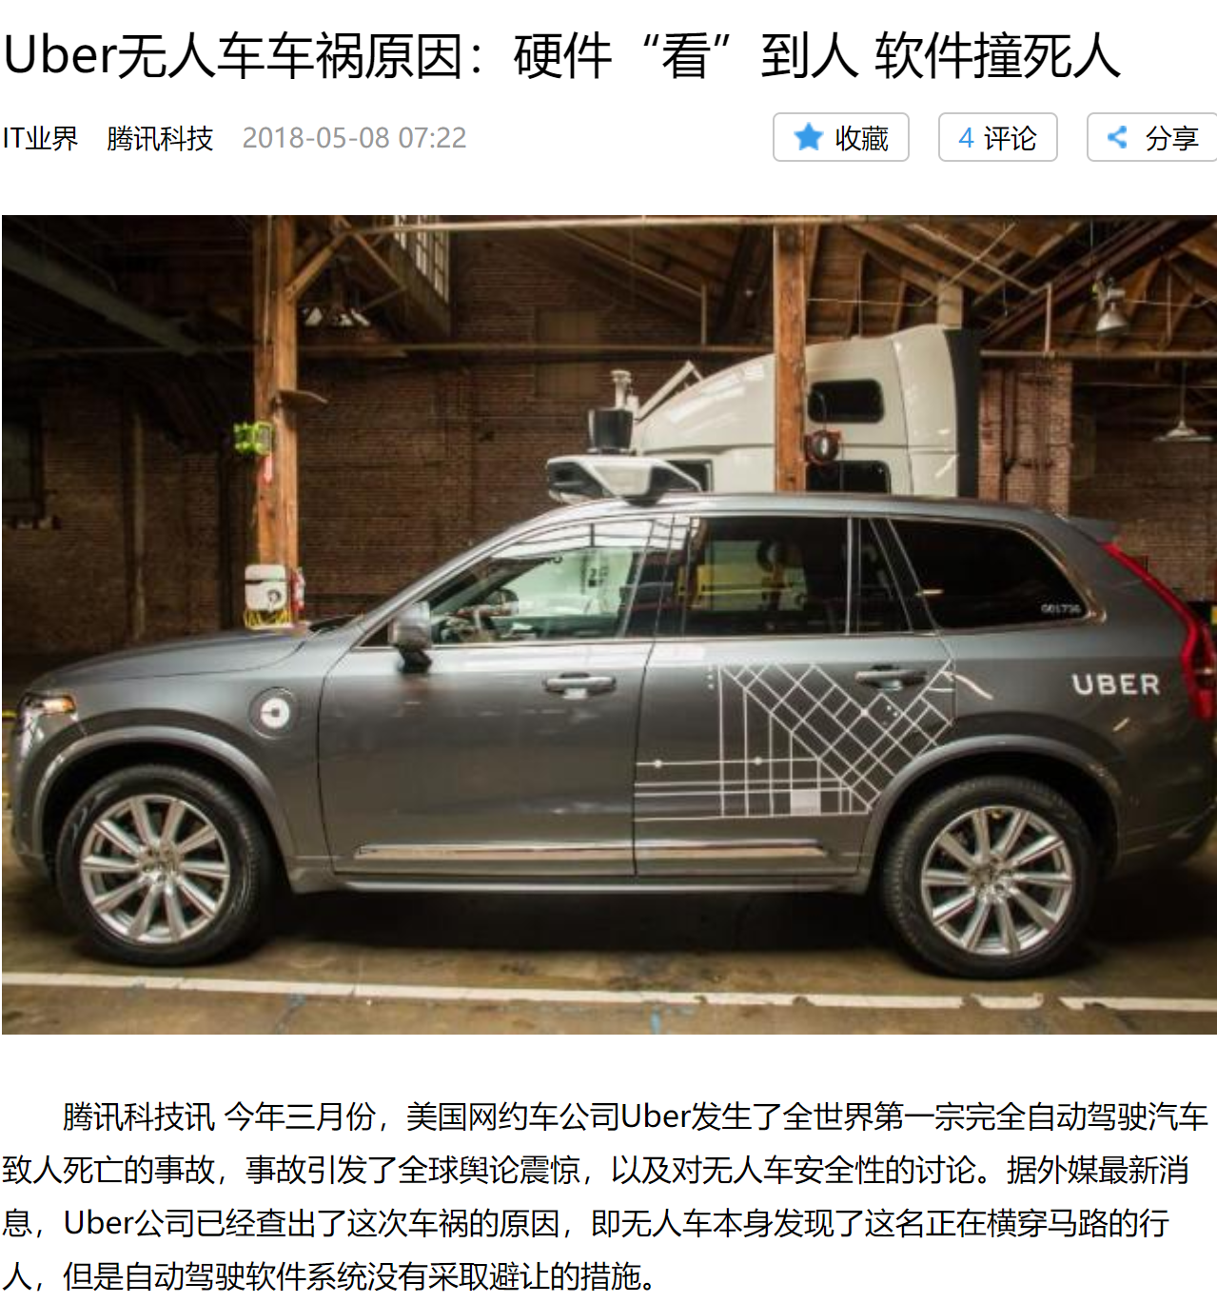
“无人车本身发现了这名正在横穿马路的行人，但是自动驾驶软件系统没有采取避让的措施。”

Slide 22
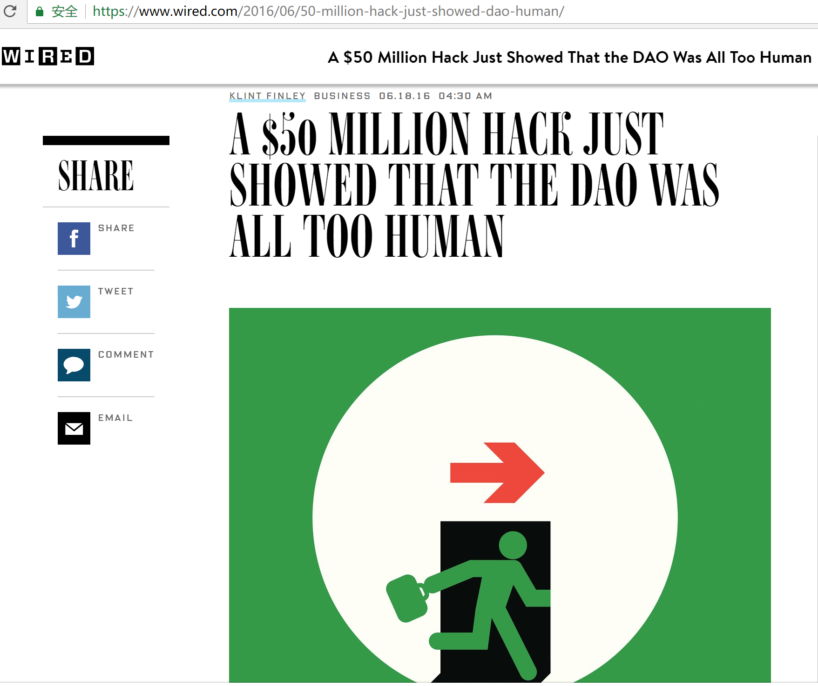
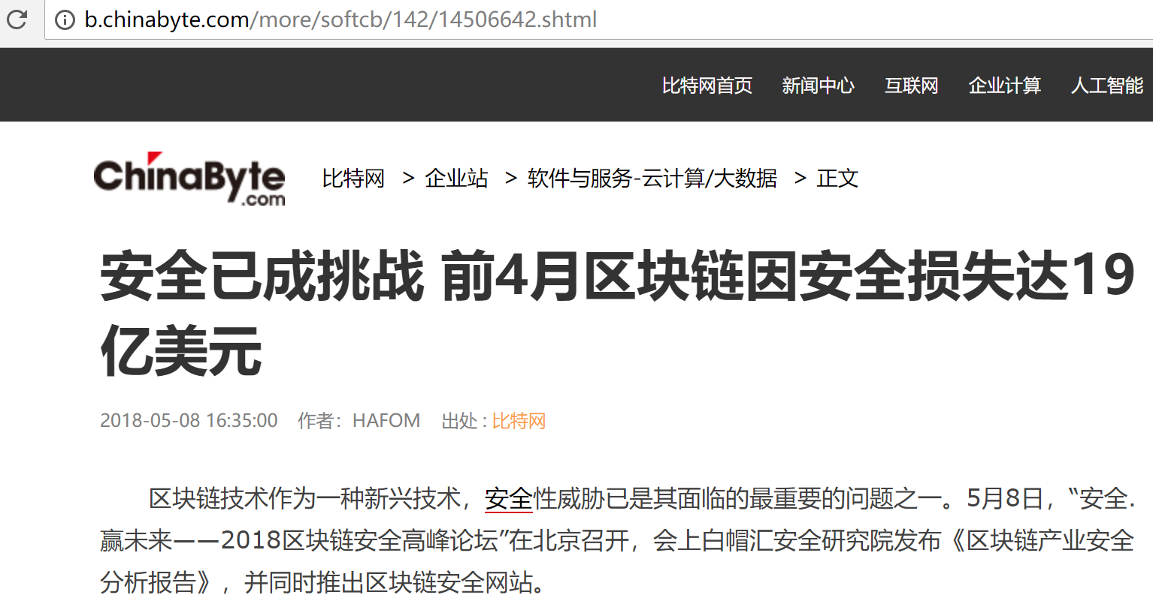

Slide 23
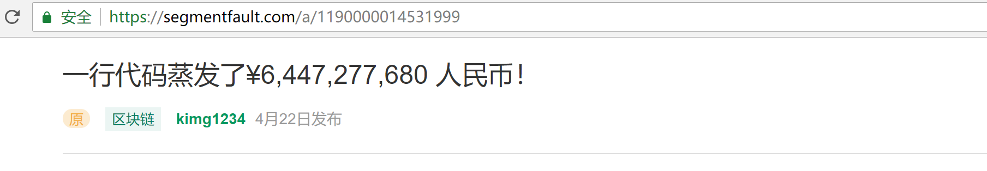
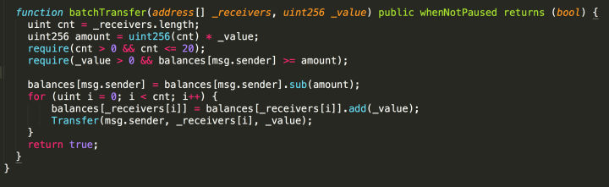
uint256 amount = uint256(cnt) * _value

Slide 24
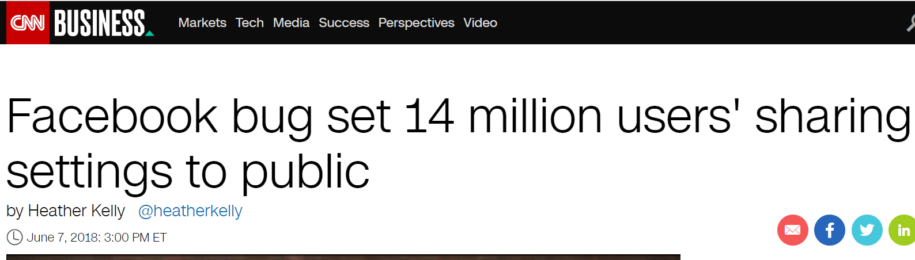

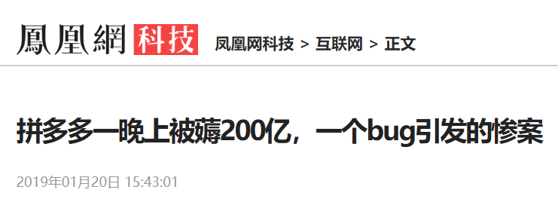
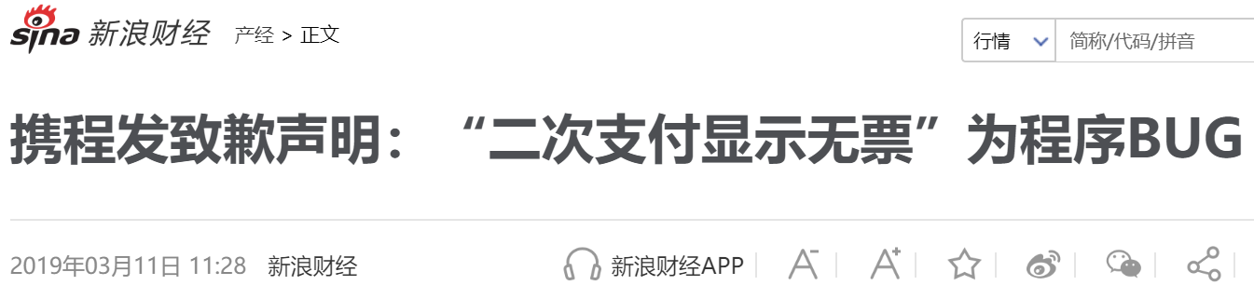
Facebook软件漏洞导致1400万用户私密帖子被公开

Slide 25
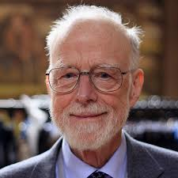
Bug-Free Software?
A grand challenge for computer scientists
  Posed since 1960’s
  Significant progress, but still challenging
Great practical implication
  Software bugs cause the loss of 59.6 billion US dollars each year (0.6% GDP)
    2002 report from NIST
  “Null References:
  The Billion Dollar Mistake”
  - Tony Hoare

Slide 26
Limitations of Testing
Simple, and easy-to-automate
Cannot guarantee the absence of bugs ☹
Testing shows the presence, not the absence of bugs.
Edsger W. Dijkstra

Slide 27
Limitations of Testing Concurrent/Distributed Programs
Hard to reproduce bugs
Thread1
Thread2
…
+
=
Concurrent Program
Interleavings
Every time you run the same program, it may give you a different result

Slide 28
Limitation of testing –
Northeast blackout, 2003
We test exhaustively, we test with third parties, and we had in excess of three million online operational hours in which nothing had ever exercised that bug. I’m not sure that more testing would have revealed that. Unfortunately, that’s kind of the nature of software… you may never find the problem. I don’t think that’s unique to control systems or any particular vendor software.
-- Mike Unum, manager at GE Energy
Race conditions in GE Energy's Unix-based XA/21 energy management system caused alarm system failure.

Slide 29
Observations
Failure often due to simple problems “in the details”.
Small theorems about large programs would be useful.
Need clearly specified interfaces and checking of interface compliance.
Better languages would help!

Slide 30
New Challenges
Software is becoming more complex nowadays:
Multi-core software
  Concurrency
Embedded software
  Limited resources
Distributed and cloud computing
  Network environment
Ubiquitous computing and Internet of Things

Slide 31
Opportunities
High assurance / reliability depends fundamentally on our ability to reason about programs.
The opportunities for new languages as well as formal semantics, type theory, computational logic, and so on, are great.

Slide 32
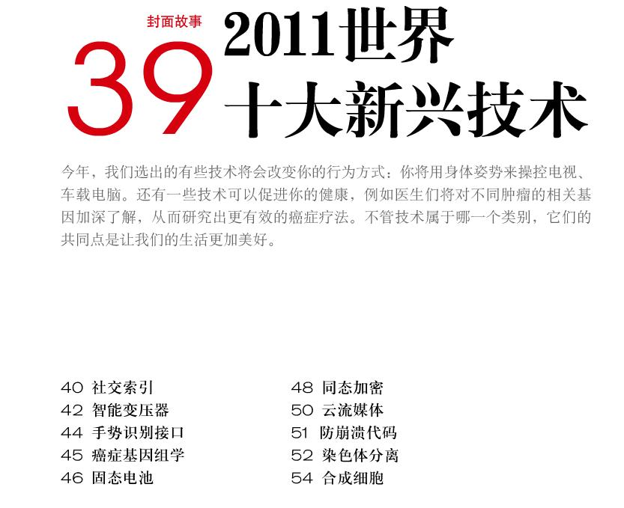

防崩溃代码

Slide 33
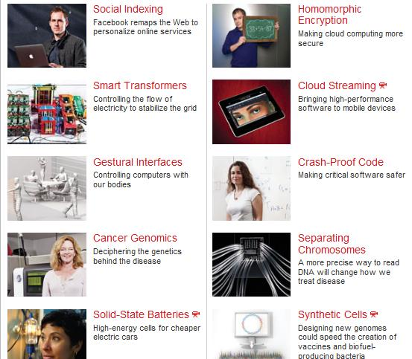
Crash-Proof Code
英文版：Technology Review, 2011(6), MIT Press
http://www.technologyreview.com/tr10/

Slide 34
Report on Crash-Proof Code
Verification of the seL4 OS kernel
  Done by the Australian group at NICTA
  Give mathematical proof showing the kernel would never crash
    How to do this mathematically?
    How to define “crash”?
    How to prove the system is “crash-proof”?
    We will answer the questions in this course

Slide 35
Why take this course
Software reliability and security are the biggest problems faced by the IT industry today! You are likely to worry about them in your future job!
It will give you an edge over your competitors: industry and most other schools don’t teach this.
It will improve your programming skills – because you will have a better appreciation of what your programs actually mean.
You will be better able to compare and contrast programming languages, or even design your own.
It’s intellectually deep: there’re many challenging and hot research problems.

Slide 36
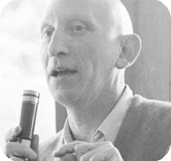
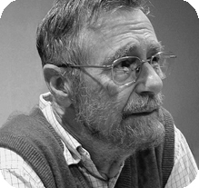
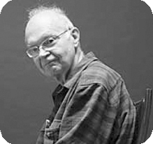
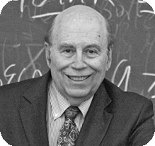
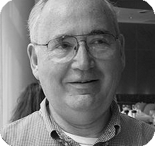
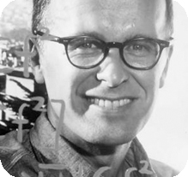
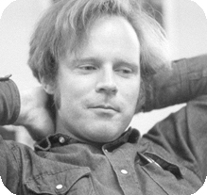
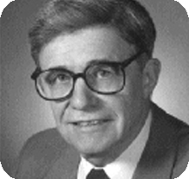
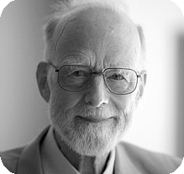
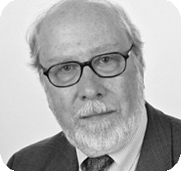
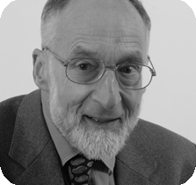
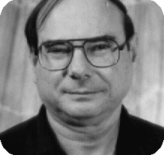
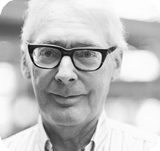
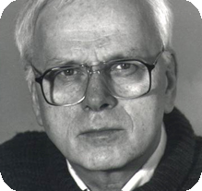
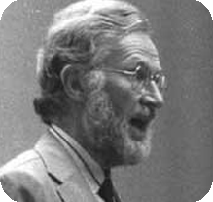
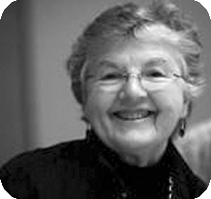
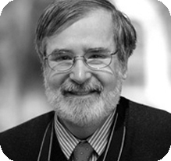
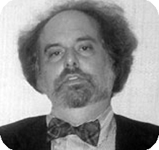
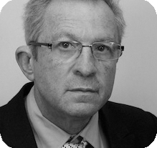
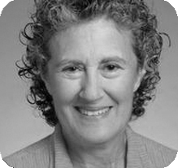
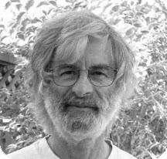
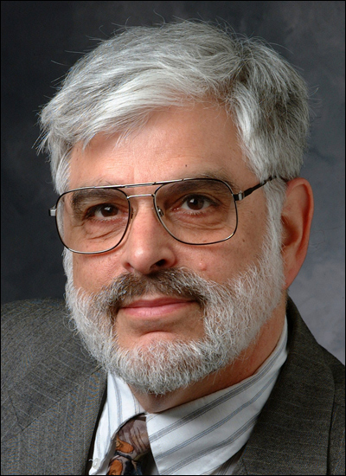
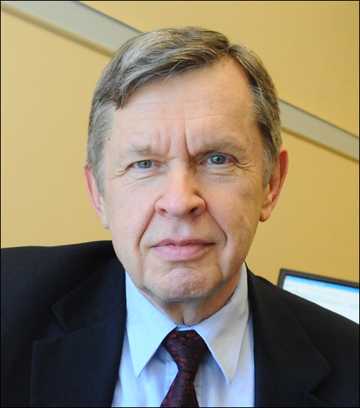
PL领域的23位图灵奖得主

Slide 37
{ f ∈ [1..N] ⟶ [1..N] |
∀ y ∈ [1..N]. ∃ x ∈ [1..N]. f(x)=y }

Slide 38
Course Overview

Slide 39
Goals of the Course
Survey existing language features
  What they mean? What they do? How they compare?
Methods to define behaviors of programs
  Operational/Denotational/Axiomatic Semantics
Methods to reason about properties of programs
  Define and prove “correctness” of programs
  Building “crash-proof” or “bug-free” software

Slide 40
Preliminary Syllabus
Introduction, Coq, Mathematical foundations
Lambda calculus
  Untyped, simply-typed, polymorphism, type operators
Imperative languages
  Operational semantics, (denotational), Hoare logic
C-like pointer programs and separation logic
Advanced Topics:
  Concurrent languages and process calculi
  Concurrency logic (CSL, RG)
  Compiler verification & CompCert

Slide 41
References
Benjamin C. Pierce, et al. Software Foundations.
https://softwarefoundations.cis.upenn.edu/
John C. Reynolds. Theories of Programming Languages. Cambridge University Press.
Robert Harper. Practical Foundations for Programming Languages.
Glynn Winskel. The Formal Semantics of Programming Languages: An Introduction. The MIT Press.
Benjamin C. Pierce. Types and Programming Languages. The MIT Press.
Hanne Riis Nielson, Flemming Nielson. Semantics with Applications: A Formal Introduction.

Slide 42
Course Requirements
Grading
  40% attendance and homework
  60% final exam
Class attendance is highly recommended
Homework: Problem sets
  No cheating!
  No late (unless special reasons provided)
Final exam is in the last class

Slide 43
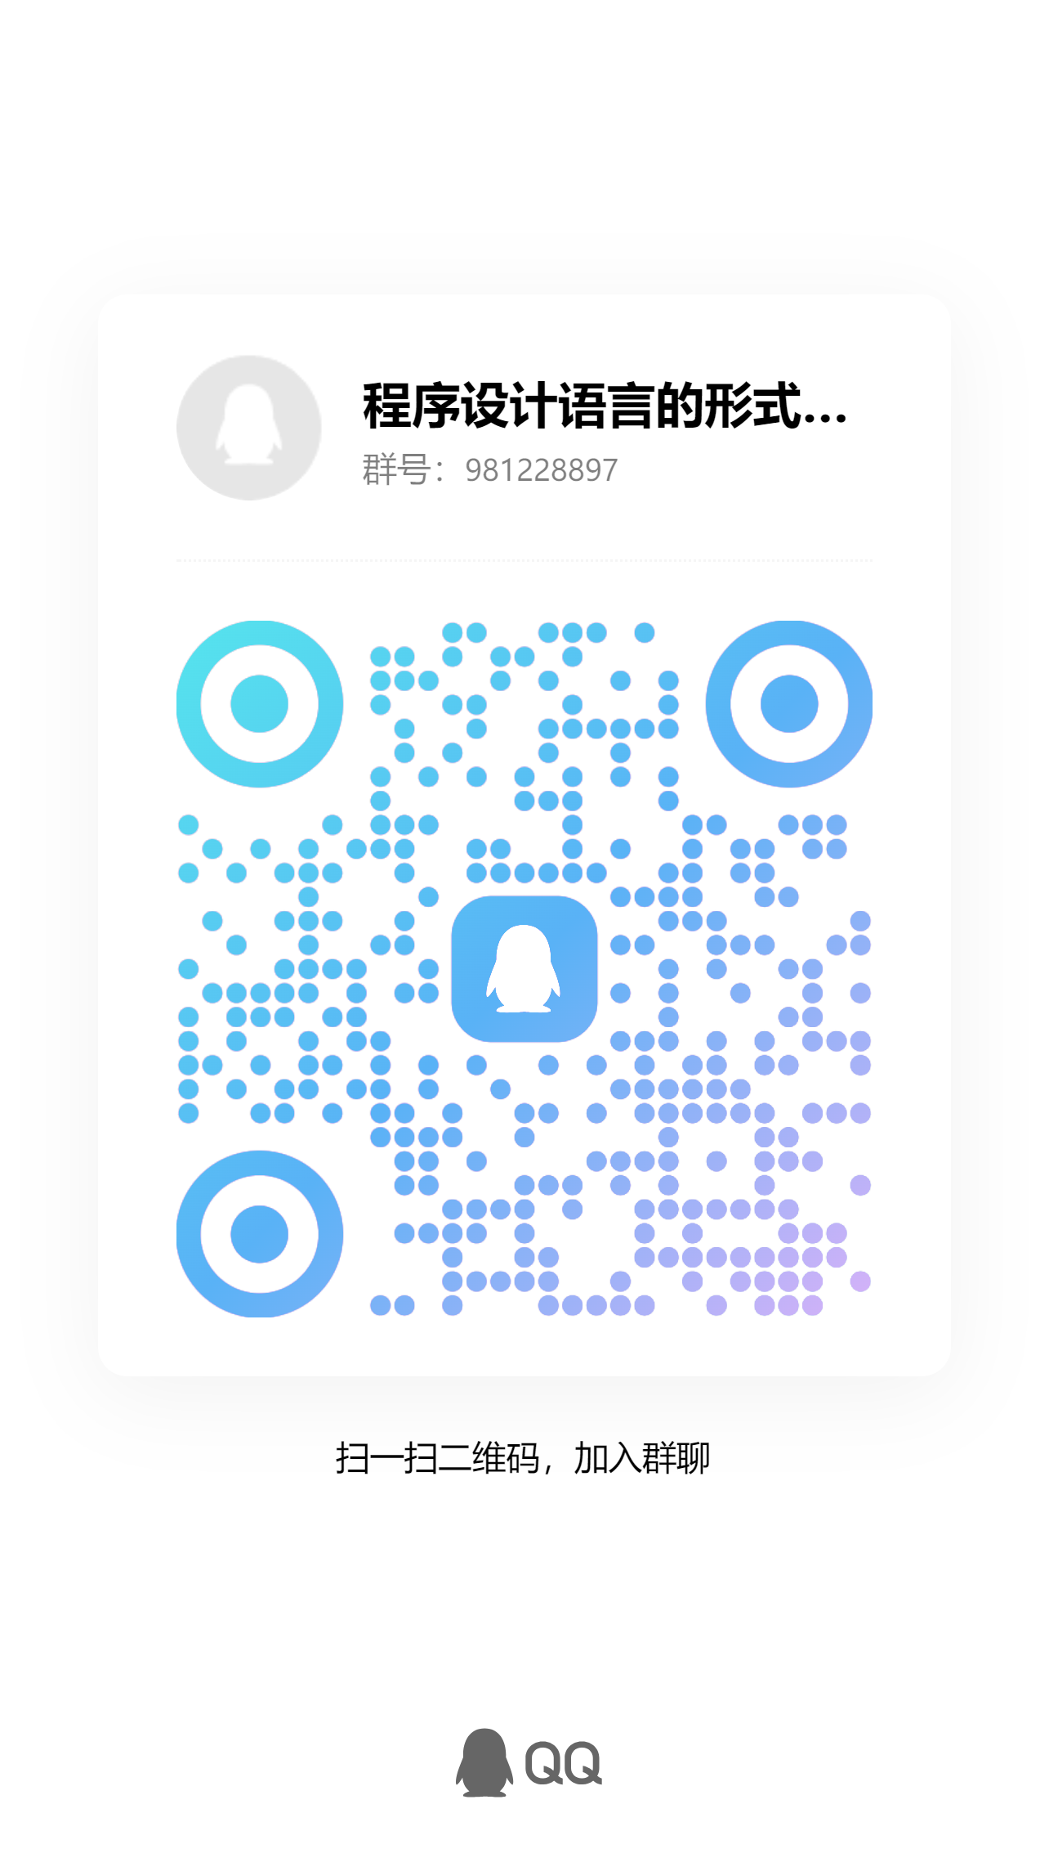
Course Webpage:
https://hongjin-liang.github.io/semantics2025/
QQ Group: 981228897
Lecture notes, homework and reading materials will all be posted on the course webpage.
You can ask questions in QQ group, or email me your questions.
Please pay attention to the updates.

