Slide 1
Lambda Calculus

Slide 2
What is λ-calculus
Programming language
  Invented in 1930s, by Alonzo Church and Stephen Cole Kleene
Model for computation
  Alan Turing, 1937: Turing machines equal λ-calculus in expressiveness

Slide 3
Why learn λ-calculus
Foundations of functional programming
  Lisp, ML, Haskell, …
Often used as a core language to study language theories
  Type system
  Scope and binding
  Higher-order functions
  Denotational semantics
  Program equivalence
  …
int x = 0;
for (int i = 0; i < 10; i++) { x++; }
x = “abcd”; // bug (mistype)
i++; // bug (out of scope)
How to formally define and rule out these bugs?

Slide 4
Overview: λ-calculus as a language
Syntax
  How to write a program?
  Keyword “λ” for defining functions
Semantics
  How to describe the executions of a program?
  Calculation rules called reduction
Others
  Type system (next class)
  Model theory (not covered)
  …

Slide 5
Syntax
λ terms or λ expressions:
(Terms) M, N ::= x | λx. M | M N
  Lambda abstraction (λx.M): “anonymous” functions
    int f (int x) { return x; } ➔ λx. x
  Lambda application (M N):
int f (int x) { return x; }
f(3);
➔ (λx. x) 3

Slide 6
Syntax
λ terms or λ expressions:
(Terms) M, N ::= x | λx. M | M N
  pure λ-calculus
Add extra operations and data types
(Terms) M, N ::= x | λx. M | M N
| c | M + N | M – N | …
  where c ∈ Int
  (This is not necessary!)

Slide 7
Conventions
Body of λ extends as far to the right as possible
λx. M N means λx. (M N), not (λx. M) N
  λx. f x = λx. ( f x )
  λx. λf. f x = λx. ( λf. f x )
Function applications are left-associative
M N P means (M N) P, not M (N P)
  (λx. λy. x - y) 5 3 = ( (λx. λy. x - y) 5 ) 3
  (λf. λx. f x) (λx. x + 1) 2 = ( (λf. λx. f x) (λx. x + 1) ) 2

Slide 8
Higher-order functions
Functions can be returned as return values
Functions can be passed as arguments
Think about function pointers in C/C++.
λx. λy. x - y
(λf. λx. f x) (λx. x + 1) 2

Slide 9
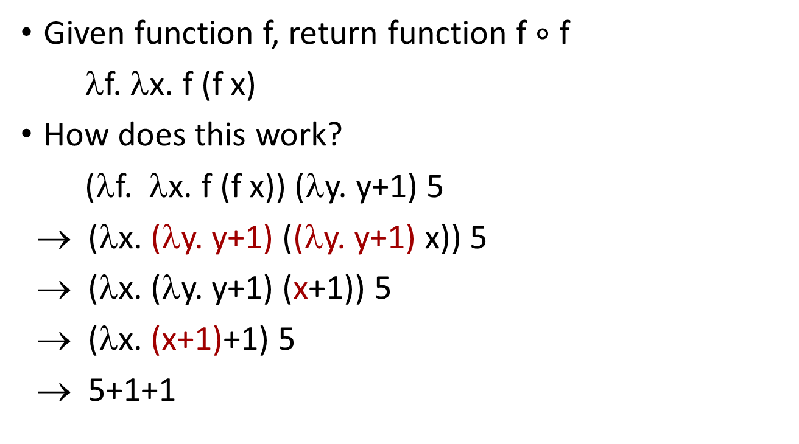
Higher-order functions
Given function f, return function f $∘$ f
λf. λx. f (f x)
How does this work?
(λf. λx. f (f x)) (λy. y+1) 5
→ (λx. (λy. y+1) ((λy. y+1) x)) 5
→ (λx. (λy. y+1) (x+1)) 5
→ (λx. (x+1)+1) 5
→ 5+1+1

Slide 10
Curried functions
Note difference between
λ abstraction is a function of 1 parameter
But computationally they are the same (can be transformed into each other)
  Curry: transform λ(x, y). x-y to λx. λy. x - y
  Uncurry: the reverse of Curry
λx. λy. x - y
and
int f (int x, int y) { return x - y;}

Slide 11
Free and bound variables
λx. x + y
  x: bound variable
  y: free variable
int y;
…
…
int add(int x) {
return x + y;
}
Could be a global variable

Slide 12
Free and bound variables
λx. x + y
Bound variable can be renamed (“placeholder”)
  λx. (x+y) is same function as λz. (z+y)
  (x+y) is the scope of the binding λx
α-equivalence
int add(int x) {
return x + y;
}
int add(int z) {
return z + y;
}
x = 0; // out of scope!

Slide 13
Free and bound variables
λx. x + y
Bound variable can be renamed (“placeholder”)
  λx. (x+y) is same function as λz. (z+y) α-equivalence
  (x+y) is the scope of the binding λx
Name of free variable does matter
  λx. (x+y) is not the same as λx. (x+z)
int y = 10;
int z = 20;
int add(int x) { return x + y; }
int y = 10;
int z = 20;
int add(int x) { return x + z; }

Slide 14
Free and bound variables
λx. x + y
Bound variable can be renamed (“placeholder”)
  λx. (x+y) is same function as λz. (z+y) α-equivalence
  (x+y) is the scope of the binding λx
Name of free variable does matter
  λx. (x+y) is not the same as λx. (x+z)
Occurrences
  (λx. x+y) (x+1) : x has both
  a free and a bound occurrence
int x = 10;
int add(int x) { return x+y;}
add(x+1);

Slide 15
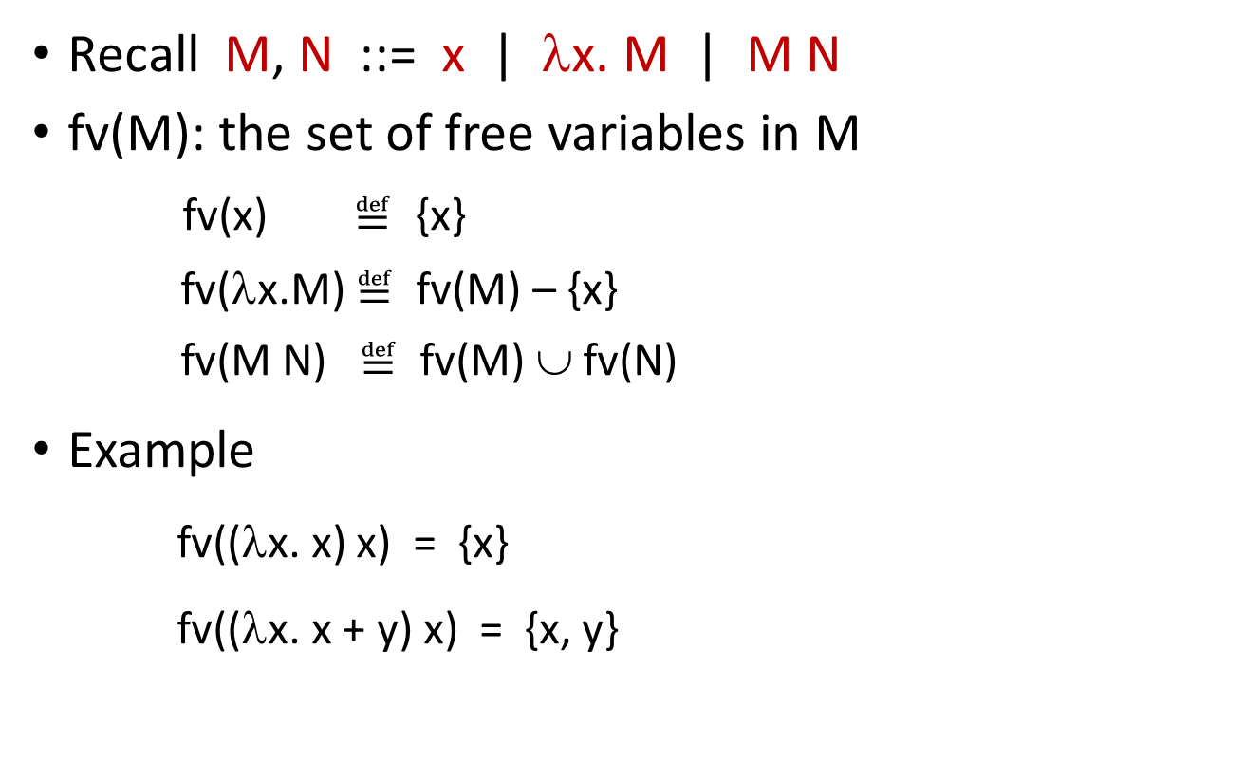
Formal definitions about free and bound variables
Recall M, N ::= x | λx. M | M N
fv(M): the set of free variables in M
fv(x) $≝$ {x}
fv(λx.M) $≝$ fv(M) – {x}
fv(M N) $≝$ fv(M) ∪ fv(N)
Example
  fv((λx. x) x) = {x}
  fv((λx. x + y) x) = {x, y}
  Defined by induction on terms

Slide 16
Formal definitions about free and bound variables
Recall M, N ::= x | λx. M | M N
fv(M): the set of free variables in M
“x is a free variable in M”: x ∈ fv(M)
“x is a bound variable in M”: ?
α-equivalence: λx. M = λy. M[y/x], where y fresh
Substitution (defined later)
(From now on, unless stated otherwise, we identify terms up to α-equivalence.)
Notes:
We regard lambda terms as equivalence classes modulo α-equivalence.

Slide 17
Main points till now
Syntax: notation for defining functions
  (Terms) M, N ::= x | λx. M | M N
Next: semantics (reduction rules)

Slide 18
Overview of reduction
Basic rule is β-reduction
(λx. M) N → M[N/x] (Substitution)
Repeatedly apply reduction rule to any sub-term
Example
(λf. λx. f (f x)) (λy. y+1) 5
→ (λx. (λy. y+1) ((λy. y+1) x)) 5
→ (λx. (λy. y+1) (x+1)) 5
→ (λx. (x+1)+1) 5
→ 5+1+1

Slide 19
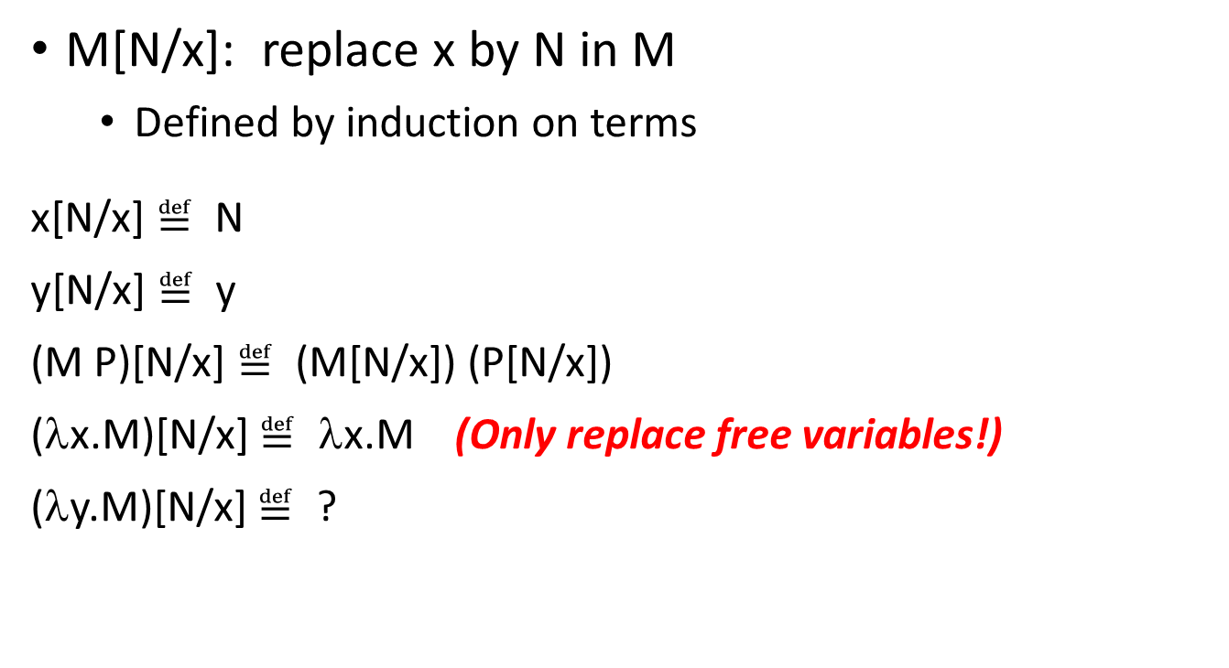
Substitution
  M[N/x]: replace x by N in M
    Defined by induction on terms
  x[N/x] $≝$ N
  y[N/x] $≝$ y
  (M P)[N/x] $≝$ (M[N/x]) (P[N/x])
  (λx.M)[N/x] $≝$ λx.M (Only replace free variables!)
  (λy.M)[N/x] $≝$ ?
Because names of bound variables do not matter

Slide 20
Substitution – avoid name capture
Example : (λx. x - y)[x/y]
Substitute “blindly”: λx. x - x
  Problem: unintended name capture!!
Solution: rename bound variables before substitution
(λx. x - y)[x/y]
= (λz. z - y)[x/y]
= λz. z - x

Slide 21
Substitution – avoid name capture
Example : (λx. f (f x))[(λy. y+x)/f]
Substitute “blindly”: λx. (λy. y+x) ((λy. y+x) x)
  Problem: x in (λy. y+x) got bound – unintended name capture!!
Solution: rename bound variables before substitution
(λx. f (f x))[(λy. y+x)/f]
= (λz. f (f z))[(λy. y+x)/f]
= λz. (λy. y+x) ((λy. y+x) z)

Slide 22
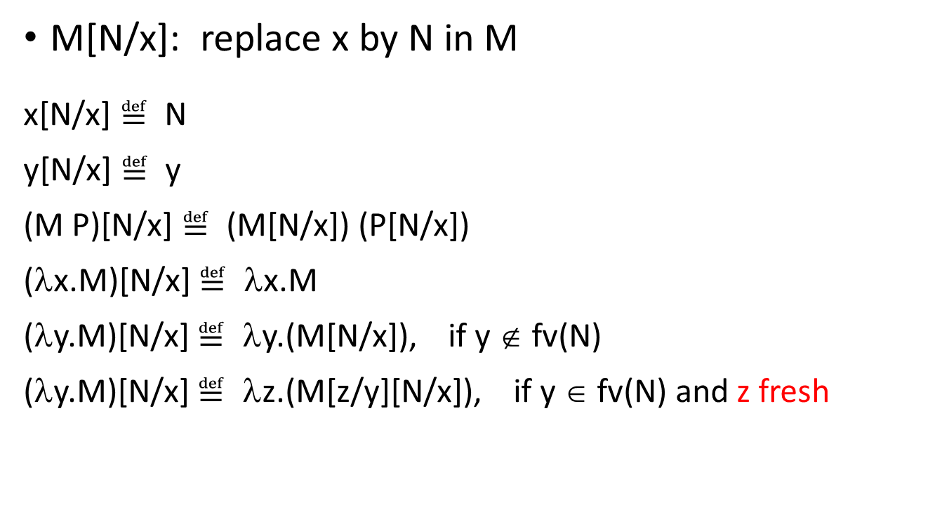
Substitution
  M[N/x]: replace x by N in M
  x[N/x] $≝$ N
  y[N/x] $≝$ y
  (M P)[N/x] $≝$ (M[N/x]) (P[N/x])
  (λx.M)[N/x] $≝$ λx.M
  (λy.M)[N/x] $≝$ λy.(M[N/x]), if y ∉ fv(N)
  (λy.M)[N/x] $≝$ λz.(M[z/y][N/x]), if y ∈ fv(N) and z fresh
z is unused
Easy rule: always rename variables to be distinct

Slide 23
Examples of substitution
(λx. (λy. y z) (λw. w) z x)[y/z]
(λx. (λy. y y) z x)[(f x)/z]

Slide 24
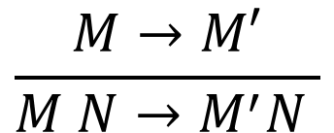
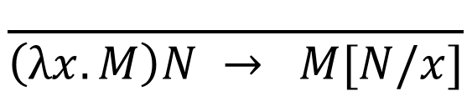
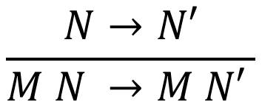
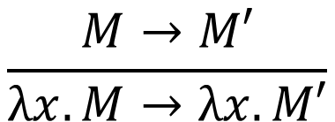
Reduction rules
$$\frac{ }{\left(λx.M\right)N → M[N/x]}$$
(β)
$$\frac{M→M′}{M N→M^{′}N }$$
$$\frac{N→N′}{M N →M N′ }$$
Repeatedly apply (β) to any sub-term
$$\frac{M→M′}{λx.M→λx.M′}$$

Slide 25
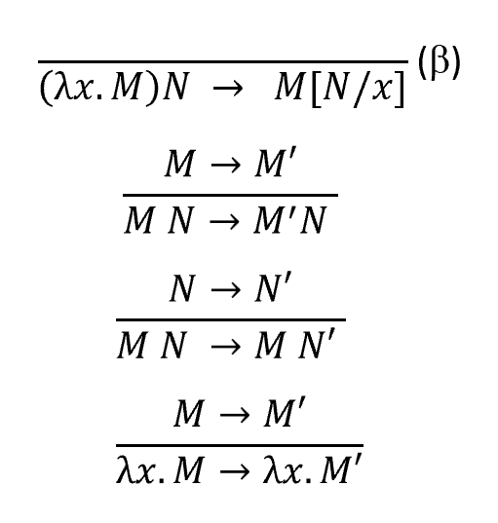
Examples
(λf. f x) (λy. y) // apply (β)
→ (f x)[(λy. y)/f]
= (λy. y) x // apply (β)
→ y[x/y]
= x

Slide 26
Examples
(λy. λx. x - y) x // apply (β)
→ (λx. x - y)[x/y]
= λz. ((x - y)[z/x][x/y])
= λz. ((z - y)[x/y])
= λz. z - x

Slide 27
Examples
λx. (λy. y+1) x // 4th rule
→ λx. x+1
(λy. y+1) x // (β) rule
→ (y+1)[x/y]
= x+1

Slide 28
Examples
(λf. λz. f (f z)) (λy. y+x) // apply (β)
→ λz. (λy. y+x) ((λy. y+x) z) // apply (β) and the 3rd &4th rules
→ λz. (λy. y+x) (z+x) // apply (β) and the 4th rule
→ λz. z+x+x

Slide 29
Normal form
reducible expression
β-redex: a term of the form (λx.M) N
β-normal form: a term containing no β-redex
  Stopping point: cannot further apply β-reduction rules
(λf. λx. f (f x)) (λy. y+1) 2
→ ( λx. (λy. y+1) ((λy. y+1) x) ) 2
→ ( λx. (λy. y+1) (x+1) ) 2
→ ( λx. x+1+1 ) 2
→ 2+1+1 (β-normal form)
Can further reduce to 4 if having reduction rules for +

Slide 30
Normal form – examples
λx. λy. x
  Yes
(λx. λy. x) (λz. z)
  No
λx. (λy. x) (λz. z)
  No

Slide 31

Confluence (Church-Rosser Property)
Terms can be evaluated in any order.
Final result (if there is one) is uniquely determined.
(λf. λx. f (f x)) (λy. y+1) 2
→ ( λx. (λy. y+1) ((λy. y+1) x) ) 2
→ ( λx. (λy. y+1) (x+1) ) 2
→ ( λx. x+1+1 ) 2
→ 2+1+1
(λf. λx. f (f x)) (λy. y+1) 2
→ ( λx. (λy. y+1) ((λy. y+1) x) ) 2
→ ( λx. (λy. y+1) (x+1) ) 2
→ (λy. y+1) (2+1)
→ 2+1+1
Notes:
合流

Slide 32
Formalizing Confluence Theorem
M →* M’ : zero-or-more steps of →
  M →⁰ M’ iff M = M’
  M →^{k+1} M’ iff ∃M’’. M → M’’ ∧ M’’ →^{k} M’
  M →* M’ iff ∃k. M→^{k} M’
Confluence Theorem:
For all M, M₁ and M₂,
if M →* M₁ and M →* M₂,
then there exists M’ such that
M₁ →* M’ and M₂ →* M’.
inductive definition
M
M₁
M₂
M’

Slide 33
Corollary of Confluence Theorem
With α-equivalence, every term has at most one normal form.
Q: If a term has many β-redexes, which β-redex should be picked?
Good news: no matter which is picked, there is at most one normal form.
Bad news: some reduction strategies may fail to find a normal form.

Slide 34
Non-terminating reduction
(λx. x x) (λx. x x)
→ (λx. x x) (λx. x x)
→ …
(λx. f (x x)) (λx. f (x x))
→ f ((λx. f (x x)) (λx. f (x x)))
→ …
(λx. x x y) (λx. x x y)
→ (λx. x x y) (λx. x x y) y
→ …
Some terms have no normal forms

Slide 35
Term may have both terminating and non-terminating reduction sequences
(λu. λv. v) ((λx. x x)(λx. x x))
→ λv. v
(λu. λv. v) ((λx. x x)(λx. x x))
→ (λu. λv. v) ((λx. x x)(λx. x x))
→ …
Some reduction strategies may fail to find a normal form

Slide 36
Reduction strategies
Normal-order reduction: choose the left-most, outer-most redex first
Applicative-order reduction: choose the left-most, inner-most redex first
Theorem:
Normal-order reduction will find normal form if exists
(λu. λv. v) ((λx. x x)(λx. x x))
→ λv. v
(λu. λv. v) ((λx. x x)(λx. x x))
→ (λu. λv. v) ((λx. x x)(λx. x x))
→ …
Notes:
leftmost: whose lambda is left to any other
outermost: not contained in any other
innermost: not contain any other

Slide 37
Reduction strategies – examples
Normal-order
Applicative-order
(λx. x x) ((λy. y) (λz. z))
→ ((λy. y) (λz. z)) ((λy. y) (λz. z))
→ (λz. z) ((λy. y) (λz. z))
→ (λy. y) (λz. z)
→ λz. z
(λx. x x) ((λy. y) (λz. z))
→ (λx. x x) (λz. z)
→ (λz. z) (λz. z)
→ λz. z

Slide 38
Reduction strategies – examples
Normal-order
Applicative-order
(λe. λf. e) ((λa. λb. a) x y) ((λc. λd. c) u v)

Slide 39
Reduction strategies – examples
Applicative-order may not be as efficient as normal-order
when the argument is not used.
Normal-order
Applicative-order
(λx. p) ((λy. y) (λz. z))
→ p
(λx. p) ((λy. y) (λz. z))
→ (λx. p) (λz. z)
→ p

Slide 40
Reduction strategies
Similar to (but subtly different from) evaluation strategies in language theories
  Call-by-name (like normal-order)
    ALGOL 60
  Call-by-need (“memoized version” of call-by-name)
    Haskell, R, …
  Call-by-value (like applicative-order)
    C, …
  …
arguments are not evaluated, but directly substituted into function body
called “lazy evaluation”
called “eager evaluation”

Slide 41
Subtle difference between reduction strategies and evaluation strategies
Normal-order (or applicative-order) reduces under lambda
  Allow optimizations inside a function body
  Not always desired
  λx. ((λy. y y) (λy. y y)) → λx. ((λy. y y) (λy. y y)) → …
Evaluation strategies: Don’t reduce under lambda

Slide 42
Evaluation
Only evaluate closed terms (i.e. no free variables)
May not reduce all the way to a normal form
  Terminate as soon as a canonical form (i.e. a lambda abstraction) is obtained
Evaluation terminates here

Slide 43
Evaluation
A closed normal form must be a canonical form
Not every closed canonical form is a normal form
Recall that normal-order reduction will find the normal form if it exists
  If normal-order reduction terminates, the reduction sequence must contain a first canonical form
  Normal-order evaluation

Slide 44
Normal-order reduction & evaluation
Normal-order reduction terminates
Normal-order reduction does not terminate
Evaluation terminates here
Evaluation terminates here
Evaluation diverges too

Slide 45

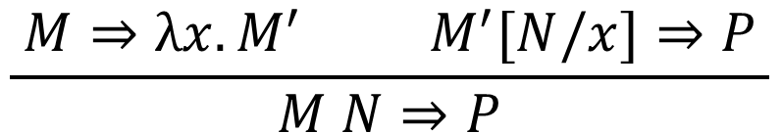
Normal-order evaluation rules
$$\frac{ }{λx.M⇒λx.M}$$
(Term)
$$\frac{ M⇒λx.M^{′} M^{′}[N/x]⇒P }{M N⇒P}$$
(β)

Slide 46
Normal-order evaluation – example
Notes:
recursive procedure

Slide 47
Recall the reduction strategies
Normal-order
Applicative-order
(λx. x x) ((λy. y) (λz. z))
→ ((λy. y) (λz. z)) ((λy. y) (λz. z))
→ (λz. z) ((λy. y) (λz. z))
→ (λy. y) (λz. z)
→ λz. z
(λx. x x) ((λy. y) (λz. z))
→ (λx. x x) (λz. z)
→ (λz. z) (λz. z)
→ λz. z
Eager evaluation:
Postpone the substitution until the argument is a canonical form. No need to reduce many copies of the argument separately.

Slide 48
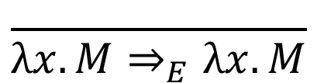
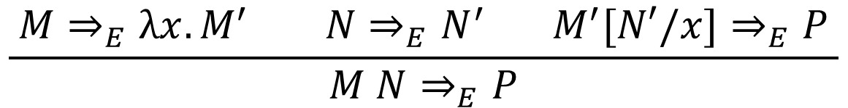
Eager evaluation rules
$$\frac{ }{λx.M⇒_{E}λx.M}$$
(Term)
$$\frac{ M⇒_{E}λx.M^{′} N⇒_{E}N^{′} M^{′}[N′/x]⇒_{E}P }{M N⇒_{E}P}$$
(β)

Slide 49
Eager evaluation
– example

Slide 50
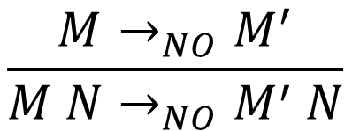
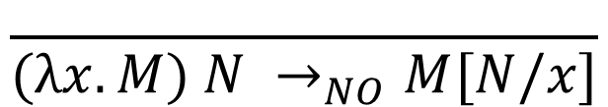
Normal-order evaluation rules (small-step)
$$\frac{ }{(λx.M) N →_{NO}M[N/x]}$$
(β)
$$\frac{M→_{NO}M^{′}}{M N→_{NO}M^{′} N}$$

Slide 51
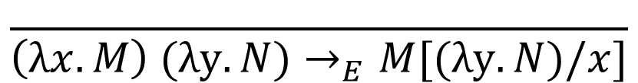
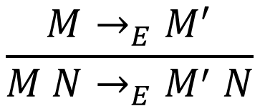
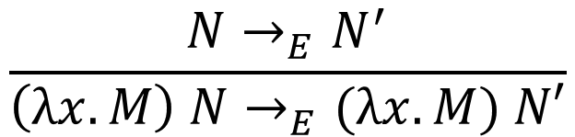
Eager evaluation rules (small-step)
$$\frac{ }{\left(λx.M\right) (λy.N)→_{E}M[(λy.N)/x]}$$
(β)
$$\frac{M→_{E}M^{′}}{M N→_{E}M^{′} N}$$
$$\frac{N→_{E}N^{′}}{\left(λx.M\right) N→_{E}(λx.M) N′}$$

Slide 52
Main points till now
Syntax: notation for defining functions
  (Terms) M, N ::= x | λx. M | M N
Semantics (reduction rules)
  (λx. M) N → M[N/x] (β)
Next: programming in λ-calculus
  Encoding data and operators in “pure” λ-calculus (without adding any additional syntax)

Slide 53

Programming in λ-calculus
Encoding Boolean values and operators
  True $≝$ λx. λy. x
  False $≝$ λx. λy. y

Slide 54

Programming in λ-calculus
Encoding Boolean values and operators
  True $≝$ λx. λy. x
  False $≝$ λx. λy. y
  not $≝$

Slide 55

Programming in λ-calculus
Encoding Boolean values and operators
  True $≝$ λx. λy. x
  False $≝$ λx. λy. y
  not $≝$ λb. b False True
not True
→ True False True
→ False
not False
→ False False True
→ True

Slide 56

Programming in λ-calculus
Encoding Boolean values and operators
  True $≝$ λx. λy. x
  False $≝$ λx. λy. y
  not $≝$ λb. b False True
  and $≝$

Slide 57

Programming in λ-calculus
Encoding Boolean values and operators
  True $≝$ λx. λy. x
  False $≝$ λx. λy. y
  not $≝$ λb. b False True
  and $≝$ λb. λb’. b b’ False
and True b
→* True b False
→ b
and False b
→* False b False
→ False

Slide 58
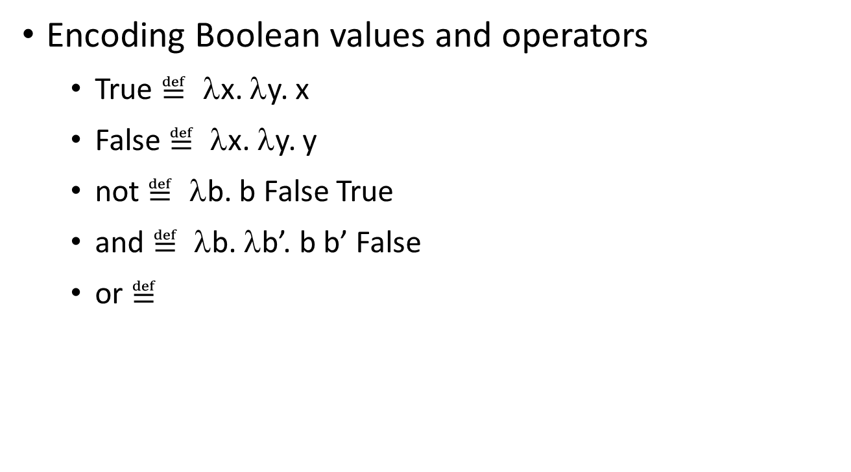
Programming in λ-calculus
Encoding Boolean values and operators
  True $≝$ λx. λy. x
  False $≝$ λx. λy. y
  not $≝$ λb. b False True
  and $≝$ λb. λb’. b b’ False
  or $≝$

Slide 59
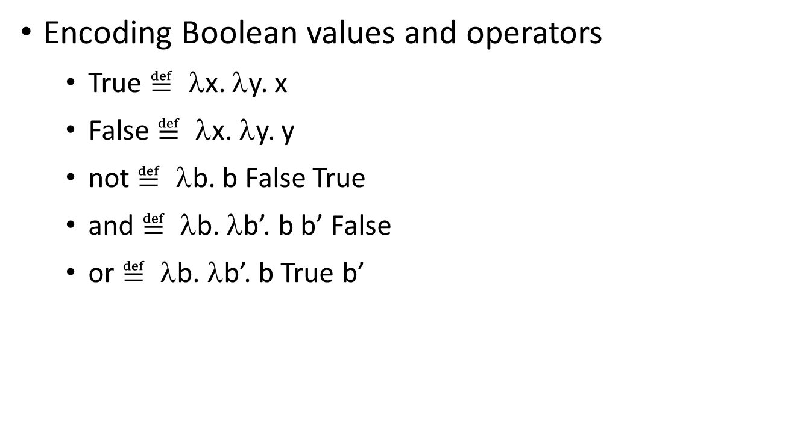
Programming in λ-calculus
Encoding Boolean values and operators
  True $≝$ λx. λy. x
  False $≝$ λx. λy. y
  not $≝$ λb. b False True
  and $≝$ λb. λb’. b b’ False
  or $≝$ λb. λb’. b True b’
or True b
→* True True b
→ True
or False b
→* False True b
→ b

Slide 60
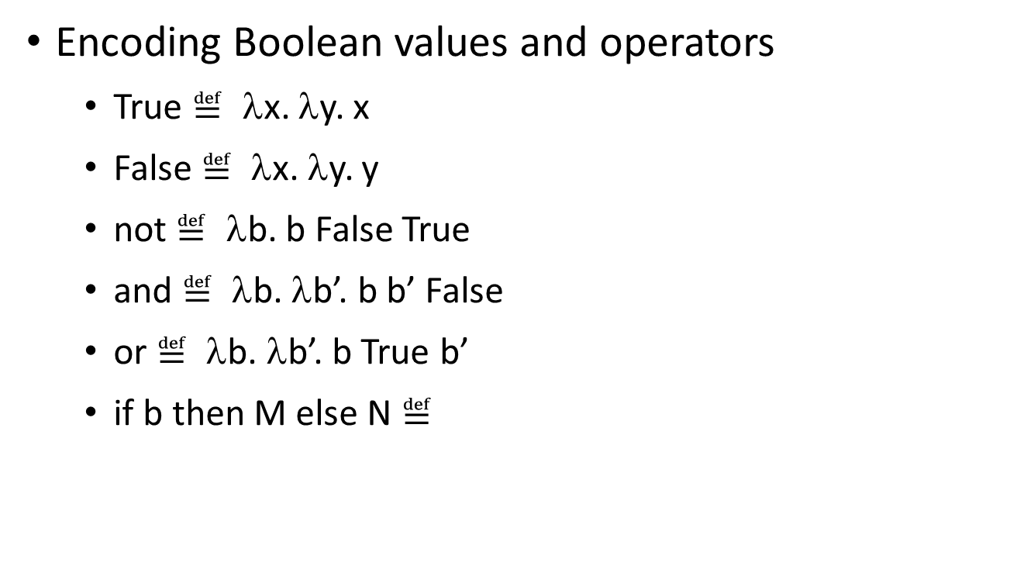
Programming in λ-calculus
Encoding Boolean values and operators
  True $≝$ λx. λy. x
  False $≝$ λx. λy. y
  not $≝$ λb. b False True
  and $≝$ λb. λb’. b b’ False
  or $≝$ λb. λb’. b True b’
  if b then M else N $≝$

Slide 61
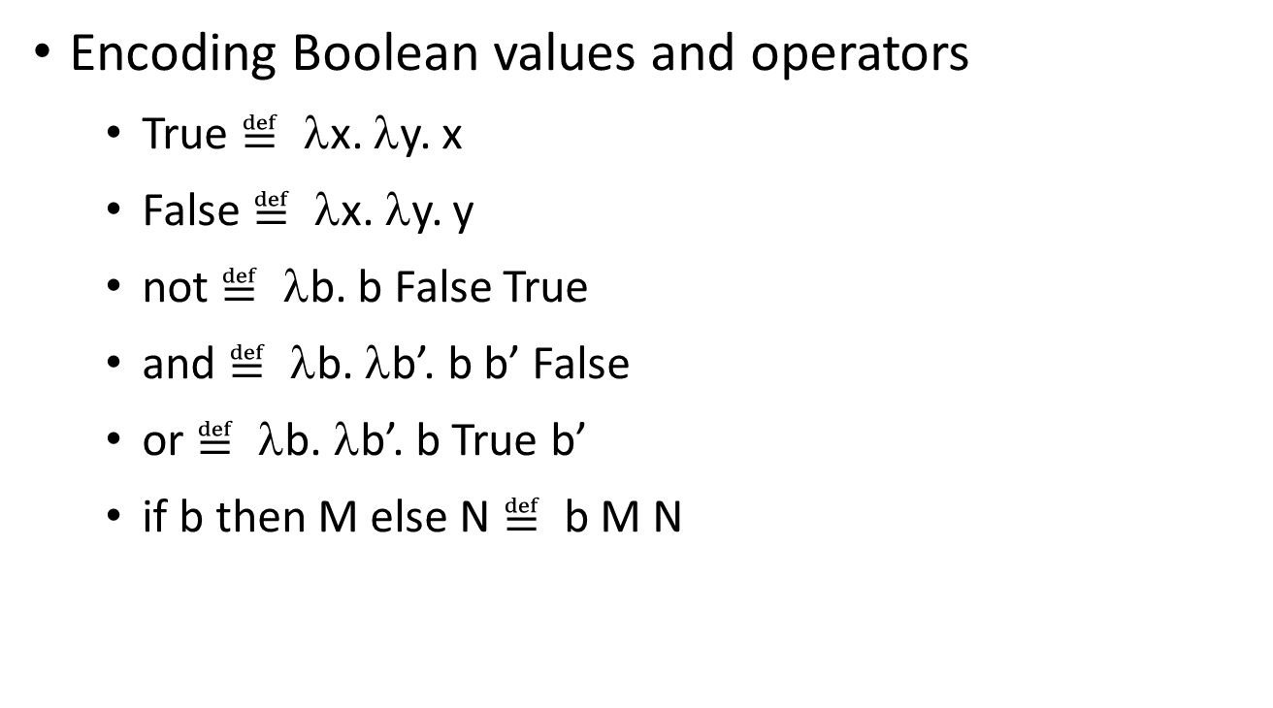
Programming in λ-calculus
Encoding Boolean values and operators
  True $≝$ λx. λy. x
  False $≝$ λx. λy. y
  not $≝$ λb. b False True
  and $≝$ λb. λb’. b b’ False
  or $≝$ λb. λb’. b True b’
  if b then M else N $≝$ b M N

Slide 62
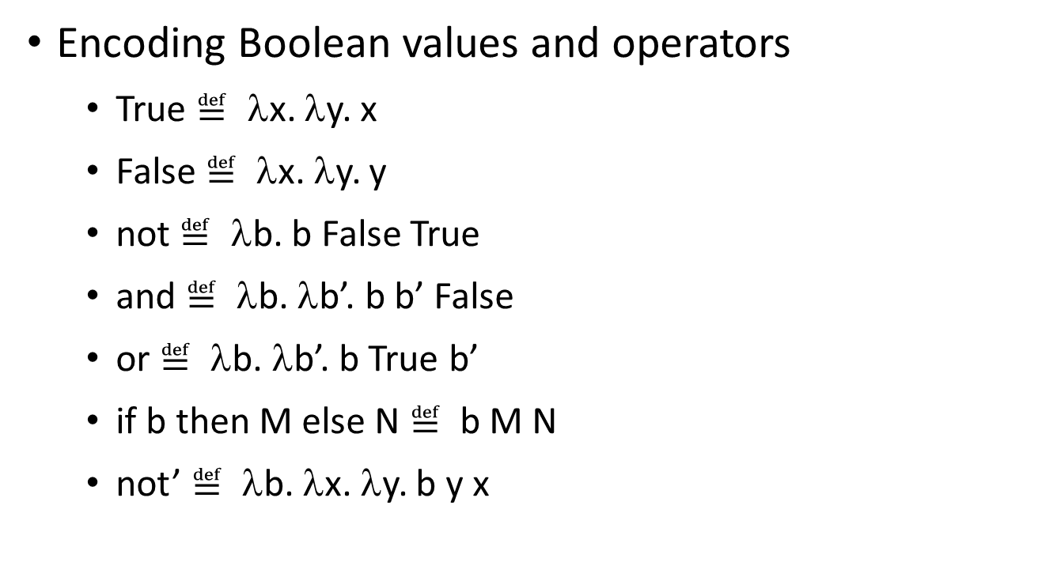
Programming in λ-calculus
Encoding Boolean values and operators
  True $≝$ λx. λy. x
  False $≝$ λx. λy. y
  not $≝$ λb. b False True
  and $≝$ λb. λb’. b b’ False
  or $≝$ λb. λb’. b True b’
  if b then M else N $≝$ b M N
  not’ $≝$ λb. λx. λy. b y x
not’ True
→ λx. λy. True y x
→ λx. λy. y = False
not’ False
→ λx. λy. False y x
→ λx. λy. x = True

Slide 63

Programming in λ-calculus
Church numerals
  0 $≝$ λf. λx. x
  1 $≝$ λf. λx. f x
  2 $≝$ λf. λx. f (f x)
  n $≝$ λf. λx. f^{n} x
this denotes λf. λx. f ( f ( …. ( f x) …))
n times

Slide 64

Programming in λ-calculus
Church numerals
  0 $≝$ λf. λx. x
  1 $≝$ λf. λx. f x
  2 $≝$ λf. λx. f (f x)
  n $≝$ λf. λx. f^{n} x
  succ $≝$

Slide 65

Programming in λ-calculus
Church numerals
  0 $≝$ λf. λx. x
  1 $≝$ λf. λx. f x
  2 $≝$ λf. λx. f (f x)
  n $≝$ λf. λx. f^{n} x
  succ $≝$ λn. λf. λx. f (n f x)
succ n
→ λf. λx. f (n f x)
  = λf. λx. f ((λf. λx. f^{n} x) f x)
  → λf. λx. f (f^{n} x)
  = λf. λx. f^{n+1} x
  = n+1

Slide 66

Programming in λ-calculus
Church numerals
  0 $≝$ λf. λx. x
  1 $≝$ λf. λx. f x
  2 $≝$ λf. λx. f (f x)
  n $≝$ λf. λx. f^{n} x
  succ $≝$ λn. λf. λx. f (n f x)
  succ’ $≝$ λn. λf. λx. n f (f x)
succ’ n →* n+1

Slide 67

Programming in λ-calculus
Church numerals
  0 $≝$ λf. λx. x
  1 $≝$ λf. λx. f x
  2 $≝$ λf. λx. f (f x)
  n $≝$ λf. λx. f^{n} x
  succ $≝$ λn. λf. λx. f (n f x)
  iszero $≝$

Slide 68

Programming in λ-calculus
iszero 0
→ λx. λy. 0 (λz. y) x
  = λx. λy. (λf. λx. x) (λz. y) x
  → λx. λy. (λx. x) x
  → λx. λy. x = True
iszero 1
→ λx. λy. 1 (λz. y) x
  = λx. λy. (λf. λx. f x) (λz. y) x
  → λx. λy. (λx. (λz. y) x) x
  → λx. λy. ((λz. y) x)
  → λx. λy. y = False
  iszero (succ n) →* False
Church numerals
  0 $≝$ λf. λx. x
  1 $≝$ λf. λx. f x
  2 $≝$ λf. λx. f (f x)
  n $≝$ λf. λx. f^{n} x
  succ $≝$ λn. λf. λx. f (n f x)
  iszero $≝$ λn. λx. λy. n (λz. y) x

Slide 69
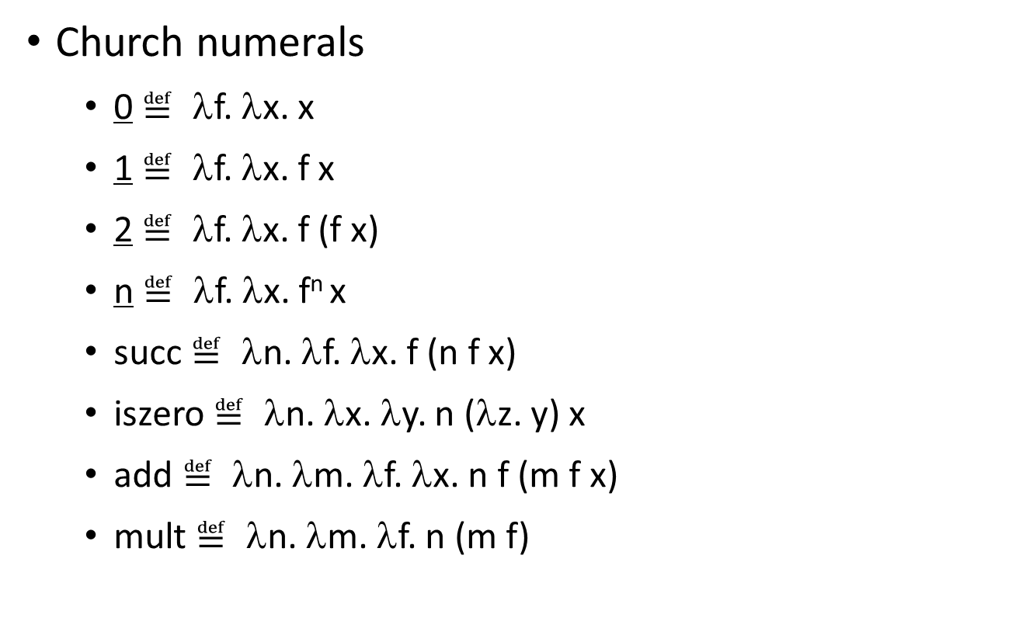
Programming in λ-calculus
Church numerals
  0 $≝$ λf. λx. x
  1 $≝$ λf. λx. f x
  2 $≝$ λf. λx. f (f x)
  n $≝$ λf. λx. f^{n} x
  succ $≝$ λn. λf. λx. f (n f x)
  iszero $≝$ λn. λx. λy. n (λz. y) x
  add $≝$ λn. λm. λf. λx. n f (m f x)
  mult $≝$ λn. λm. λf. n (m f)

Slide 70

Programming in λ-calculus
Pairs
  (M, N) $≝$ λf. f M N
  π₀ $≝$ λp. p (λx. λy. x)
  π₁ $≝$ λp. p (λx. λy. y)
π₀(M, N) →* M
π₁(M, N) →* N

Slide 71

Programming in λ-calculus
Pairs
  (M, N) $≝$ λf. f M N
  π₀ $≝$ λp. p (λx. λy. x)
  π₁ $≝$ λp. p (λx. λy. y)
Tuples
  (M₁, …, M_{n}) $≝$ λf. f M₁ … M_{n}
  π_{i} $≝$ λp. p (λx₁. … λx_{n}. x_{i})

Slide 72
Programming in λ-calculus
Recursive functions
  fact(n) = if (n == 0) then 1 else n * fact(n-1)
  To find fact, we need to solve an equation!

Slide 73
Fixpoint in arithmetic
x is a fixpoint of f if f(x) = x
Some functions has fixpoints, while others don’t
  f(x) = x * x. Two fixpoints 0 and 1.
  f(x) = x + 1. No fixpoint.
  f(x) = x. Infinitely many fixpoints.

Slide 74
fact is a fixpoint of a function
x is a fixpoint of f if f(x) = x
  fact(n) = if (n == 0) then 1 else n * fact(n-1)
  fact = λn. if (n == 0) then 1 else n * fact(n-1)
  fact = (λf. λn. if (n == 0) then 1 else n * f(n-1)) fact
  Let F = λf. λn. if (n == 0) then 1 else n * f(n-1).
  Then fact = F fact. So fact is a fixpoint of F.

Slide 75
In λ-calculus, every term has a fixpoint
Fixpoint combinator is a higher-order function h satisfying
for all f, (h f) gives a fixpoint of f
i.e. h f = f (h f)
We'll see some terms that are fixpoint combinators
Wait, what is "=" ?
Notes:
h f = f (h f): beta-equivalence (if the two sides can reduce to the same normal form)

Slide 76
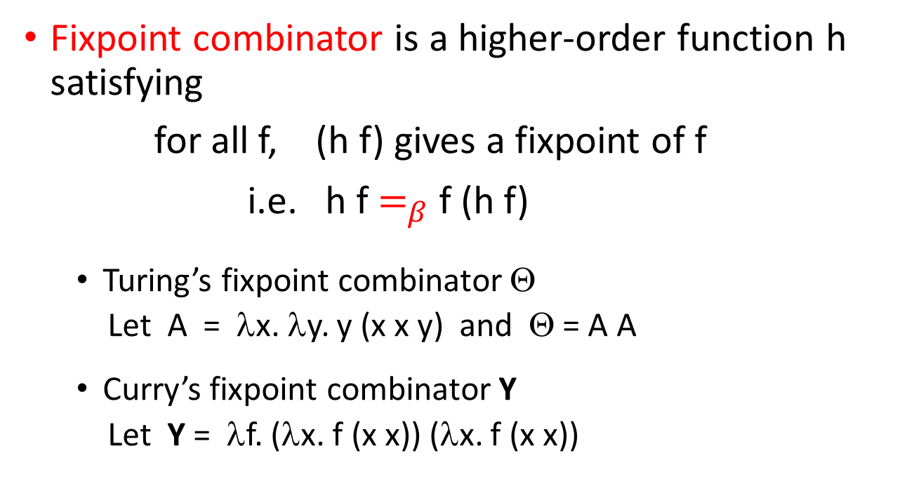
In λ-calculus, every term has a fixpoint
Fixpoint combinator is a higher-order function h satisfying
for all f, (h f) gives a fixpoint of f
i.e. h f $=_{β}$ f (h f)
  Turing’s fixpoint combinator Θ
  Let A = λx. λy. y (x x y) and Θ = A A
  Curry’s fixpoint combinator Y
  Let Y = λf. (λx. f (x x)) (λx. f (x x))
Notes:
h f = f (h f): beta-equivalence (if the two sides can reduce to the same normal form)

Slide 77

Turing’s fixpoint combinator Θ
  Let A = λx. λy. y (x x y) and Θ = A A
  Let’s prove: for all f, Θ f $=_{β}$ f (Θ f)
Notes:
The last = is beta-equivalence. We just prove the left side can reduce to the right side.

Slide 78
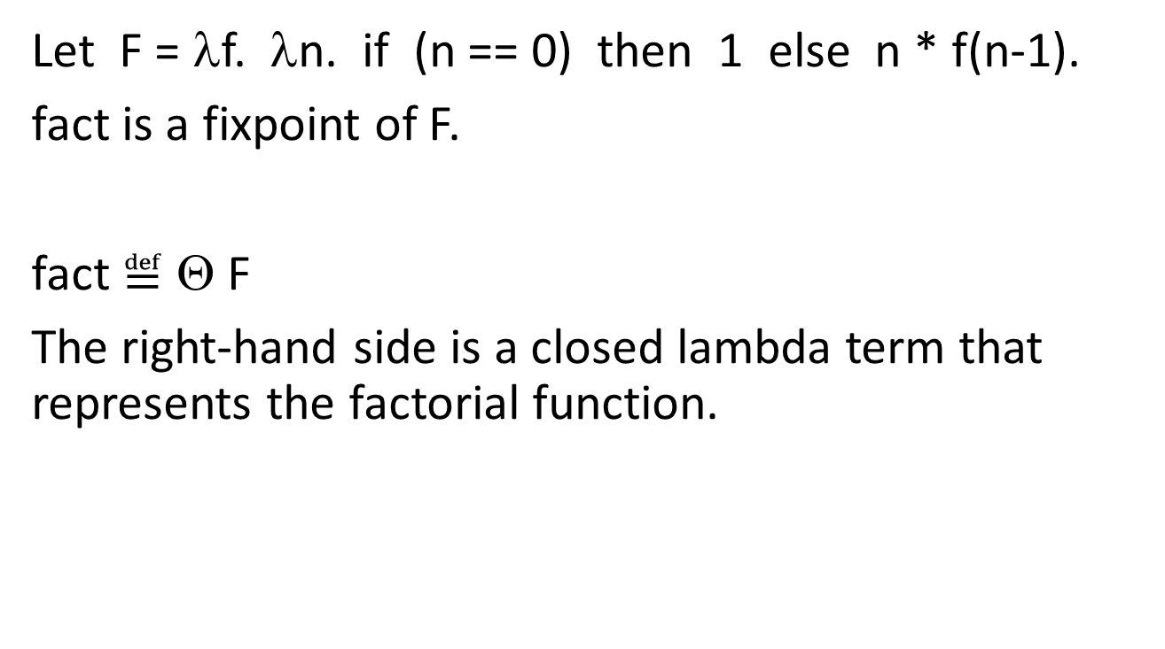
Solving fact
Let F = λf. λn. if (n == 0) then 1 else n * f(n-1).
fact is a fixpoint of F.
fact $≝$ Θ F
The right-hand side is a closed lambda term that represents the factorial function.

Slide 79
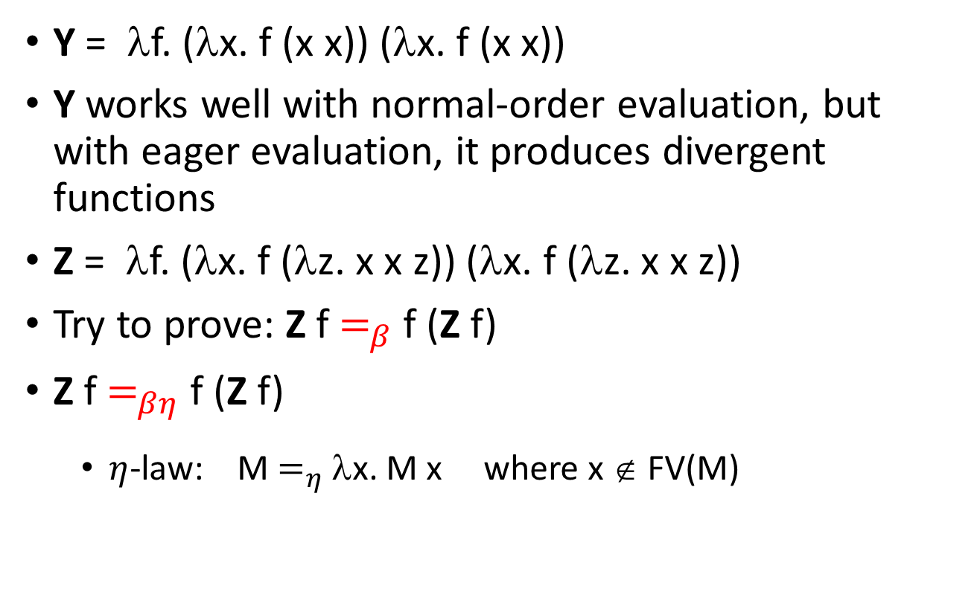
Curry’s fixpoint combinator Y
Y = λf. (λx. f (x x)) (λx. f (x x))
Y works well with normal-order evaluation, but with eager evaluation, it produces divergent functions
Z = λf. (λx. f (λz. x x z)) (λx. f (λz. x x z))
Try to prove: Z f $=_{β}$ f (Z f)
Z f $=_{βη}$f (Z f)
  $η$-law: M $=_{η}$ λx. M x where x ∉ FV(M)

Slide 80
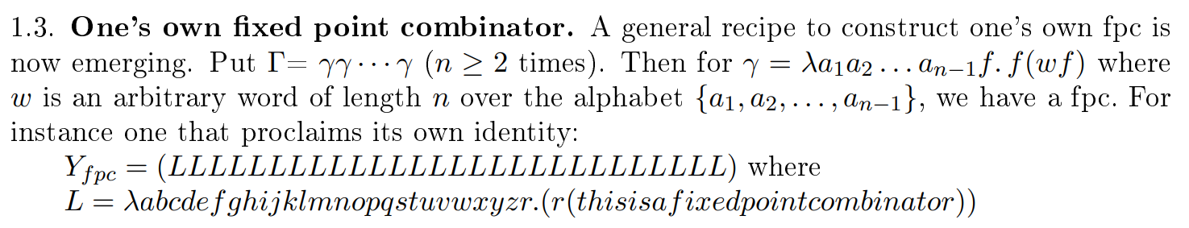
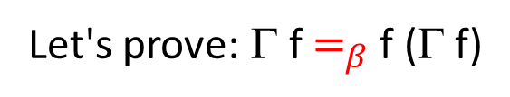
There’re infinitely many fixpoint combinators
Turing’s fixpoint combinator Θ: (λx. λy. y (x x y)) (λx. λy. y (x x y))
Let's prove: Γ f $=_{β}$ f (Γ f)
Jan Willem Klop: New Fixed Point Combinators From Old
https://www.cs.ru.nl/barendregt60/essays/klop/art16_klop.pdf

Slide 81
Comments on computability
Turing’s Turing machine, Church’s λ-calculus and Gödel’s general recursive functions are equivalent to each other in the sense that they define the same class of functions (a.k.a computable functions).
This is proved by Church, Kleene, Rosser, and Turing.

Slide 82
Programming in λ-calculus
Booleans
Natural numbers
Pairs
Lists
Trees
Recursive functions
…
Read supplementary materials on course website

Slide 83
Main points about λ-calculus
Succinct function expressions
  λ
  Bound variables can be renamed
Reduction via substitution
Can be extended with
  Types (next class)
  Side-effects (not covered)

